Slide 1
QA Techniques: Testing: Introduction
Dr Steffen Zschaler
Notes:
<CTRL-SHIFT-HOME><CTRL-SHIFT-2>
Welcome.
For the remainder of this week, we will focus on one particular verification technique: testing.

Slide 2
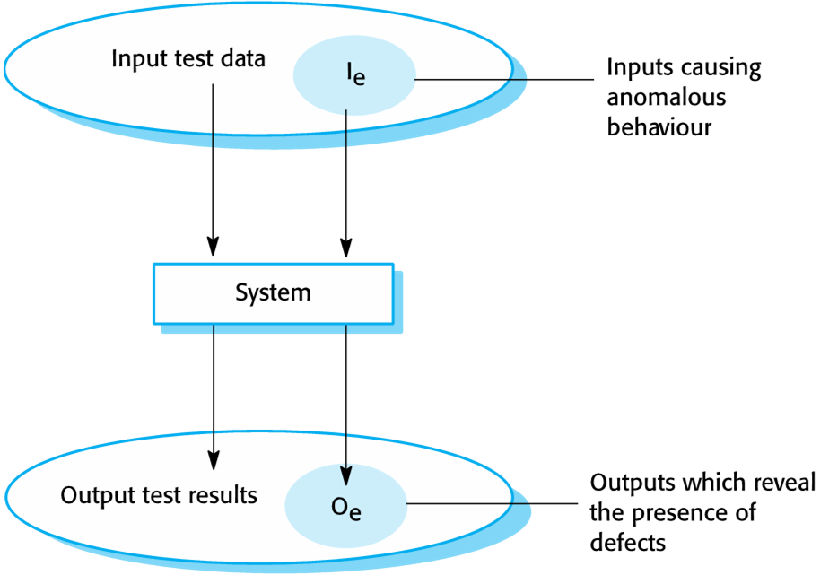
Program testing
Testing intends to …
Show a program does what it is intended to do
Discover program defects before program is put into use
Testing means …
Executing a program using artificial data
Checking test results for errors, anomalies, or information about non-functional attributes
Testing can reveal the presence of errors NOT their absence
Notes:
The purpose of testing is to show that a program does what it is intended to do and to discover defects before the program is put into use.
<ANIMATE>
Testing means to execute a program (or parts thereof) using artificial data and then check the program response against a predicted response.
<ANIMATE>
As such, testing can identify existing errors, but it cannot guarantee freedom from errors.
For example, we might simply not have tested the program with the input data that would have revealed an error.
Complete coverage of the set of input data is neither feasible nor desirable: for most real-world systems, the set of possible input data is infinite.

Slide 3
Program testing goals
Demonstrate to developer and customer that software meets its requirements
Custom software: at least one test for every requirement in the requirements document
Generic software products: tests for all of the system features, plus combinations of these features
Test cases reflect system’s expected use
→ Validation Testing
Discover situations in which software behavior is incorrect or undesirable
Root out undesirable system behavior such as system crashes, unwanted interactions with other systems, incorrect computations and data corruption
Test cases designed to expose defects
Can be deliberately obscure and need not reflect how the system is normally used
→ Defect testing
Notes:
We differentiate two types of testing based on what their goals are:
Validation testing aims to demonstrate that software meets its requirements. This isn’t about demonstrating freedom from defects, but more of a sanity check to demonstrate that all features have been implemented and work essentially correctly.
<ANIMATE> Defect testing, on the other hand, aims to root out error situations so the errors can be fixed before the software goes into production use. While validation tests should reflect typical system usage, defect tests can be quite obscure and focused on demonstrating an error rather than a realistic usage scenario. The point is to demonstrate that an error can be caused to happen not to demonstrate that this would happen in the course of “vanilla” use of the software.

Slide 4
Testing vs Inspections
Testing
Exercise and observe product behaviour (dynamic verification)
System is executed with test data and its operational behaviour is observed
Inspections
Analysis of static system representation to discover problems (static verification)
May be supplemented by tool-based document and code analysis
Notes:
We have previously spoken about inspections (or reviews). How does testing and inspection compare?
The biggest difference is that testing focuses on dynamic execution while inspections focus on static analysis of the system without execution.
This has a number of implications, most importantly that inspections can be used for artefacts that cannot be executed, such as documentation or requirements specifications.

Slide 5
Test vs Inspections (2)
Testing
Errors can mask (hide) other errors
Need specialized test harnesses to test incomplete systems (mocking)
Cannot test “static” system properties
Can test non-functional characteristics such as performance, usability, etc.
Inspections
Static process: interactions between errors not a concern
Incomplete versions of a system can be inspected without additional costs
Can also consider broader quality attributes, such as compliance with standards, portability, maintainability
Inspections cannot check dynamic properties reliably
Inspections and testing are complementary and not opposing verification techniques
Both should be used during the V & V process
Notes:
Here are some other consequences of this key difference between testing and inspections:
Because tests rely on executing the software, some errors may be masked by other errors: if the program throws an exception, this is where we initially assume the error to be, even though an earlier, unreported error, may have led to the problem occurring here.
Even worse, it may be possible for two errors to cancel each other out so that no error is reported by the overall test run.
In contrast, inspections look at the code statically and can better identify potential interactions between errors.
Testing incomplete systems is often complicated, requiring additional setup of test harnesses to mock up the non-existent system parts.
Inspections doesn’t need an executable system and, thus, has no need for mocking up missing system parts.
Testing can only test dynamic properties. In contrast, inspection can also check properties such as maintainability, adherence to standards etc. However, analysing dynamic properties of a system through inspection can become quite difficult.
In contrast, tests can be written to test many quality properties, including performance or security. Inspections struggle with such properties.
In all, inspections and testing shouldn’t be treated as mutually exclusive. Instead, a good quality assurance plan will aim to use a mix of testing and inspection.

Slide 6
A model of the software testing process
Notes:
Here is an overview of the overall testing process. Note that I am showing the process as if it was a fairly linear thing here, but in reality we may be at different stages of the process for different tests that we are using.
In the diagram, boxes represent data and boxes with rounded edges represent activities.
We start by designing a test case, that is a sequence of steps that we need to undertake with the software to execute a test.
Test cases are parametrised and, in the next step, we prepare the test data, which we will use to instantiate the parameters of each test.
Once we have the test data prepared, we can run our tests by executing the steps of the test case against the software system, using the parameters provided by the test data set.
This produces some test results.
By inspecting our test case, we can identify the expected test result and compare this against the real test result.
We, finally, report the results of the test run.

Slide 7
Stages of testing
Development testing
System is tested during development to discover bugs and defects
Release testing
A separate testing team test a complete version of the system before it is released to users
User testing
Users or potential users of a system test the system in their own environment
Notes:
For a big system, we differentiate several stages of testing:
Development testing is done during development and tests are often written by the original developers
Release testing is undertaken by a separate independent team to assess the system quality before the system is delivered to users
User testing is where users test the system in their own context.
For the rest of the week, we will discuss each of these in more detail, starting with <ANIMATE> Development testing in the next video on KEATS.
<CTRL-SHIFT-END>

